Slide 1
SystemVerilog HDL Workshop #3
044252 - Digital Systems and Computer Structure

Slide 2
Topics Covered Last Time
Hardware Description Languages
SystemVerilog Building Blocks:
Values / Number representation
Bitwise operators
Module implementation
Module instantiation
Concurrent assignments
Procedural blocks
Parameters
Parallelism in HDL
Test benches and simulation

Slide 3
Topics Covered Last Time
Hardware Description Languages
SystemVerilog Building Blocks:
Values / Number representation
Bitwise operators
Module implementation
Module instantiation
Concurrent assignments
Procedural blocks
Parameters
Parallelism in HDL
Test benches and simulation

Slide 4
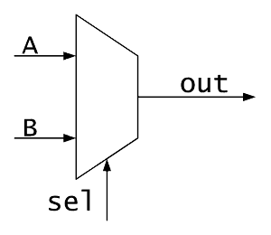
Module Instantiation - Recap
2-bit wide mux from two 1-bit muxes
A[1:0]
A]0[
B]0[
O[1:0]
module mux2to1_2 (
output logic [1:0] O,
input logic [1:0] A,
input logic [1:0] B,
input logic sel
);
mux2to1 mux0 (.out(O[0]), .sel(sel), .A(A[0]), .B(B[0]));
mux2to1 mux1 (.out(O[1]), .sel(sel), .A(A[1]), .B(B[1]));
endmodule
B[1:0]
A]1[
B]1[
sel

Slide 5
Concurrent Assignments - Recap
Connect a wire to a combinational logic or another wire
When the right-hand-side of an assignment changes, it immediately flows through to the left-hand-side wire
Syntax:
logic signal;
assign signal = 1'b0;
logic signal1;
logic signal2;
assign signal2 = signal1;

Slide 6
Procedural Blocks - Recap
Sequential: all statements inside the block are executed sequentially
One line after the other
Two procedural constructs:
initial:
always_comb:
initial begin
<statement1>;
# time_to_wait
<statement2>;
# time_to_wait
...
end
always_comb begin
<statement1>;
<statement2>;
...
end

Slide 7
Agenda
More operators
Conditional statements
Synchronous logic and assignments
Test benches for synchronous logic

Slide 8
Agenda
More operators
Conditional statements
Synchronous logic and assignments
Test benches for synchronous logic

Slide 9
Relational Operators
Meaning | Operator
Less than | <
Less than or equal to | <=
Greater than | >
Greater than or equal to | >=
Equal to | ==
Not equal to | !=
All of these return a 1-bit logical value (true/false or ‘x’)

Slide 10
Logical Operators
Used for conditions
Operands evaluated to 1-bit value: 0 (false), 1 (true) or x
Result is 1-bit value: 0 (false), 1 (true) or x
Meaning | Operator
Logical AND | &&
Logical OR | ||
Logical NOT | !

Slide 11
Logical Operators
logic A, B, C;
assign A = 1'b1;
assign B = 1'b0;
assign C = 1'bx;
Examples:
false | true && false → | A && B →
true | true || true → | A || !B →
x | x || false → | C || B →
false | x && false → | C && B →

Slide 12
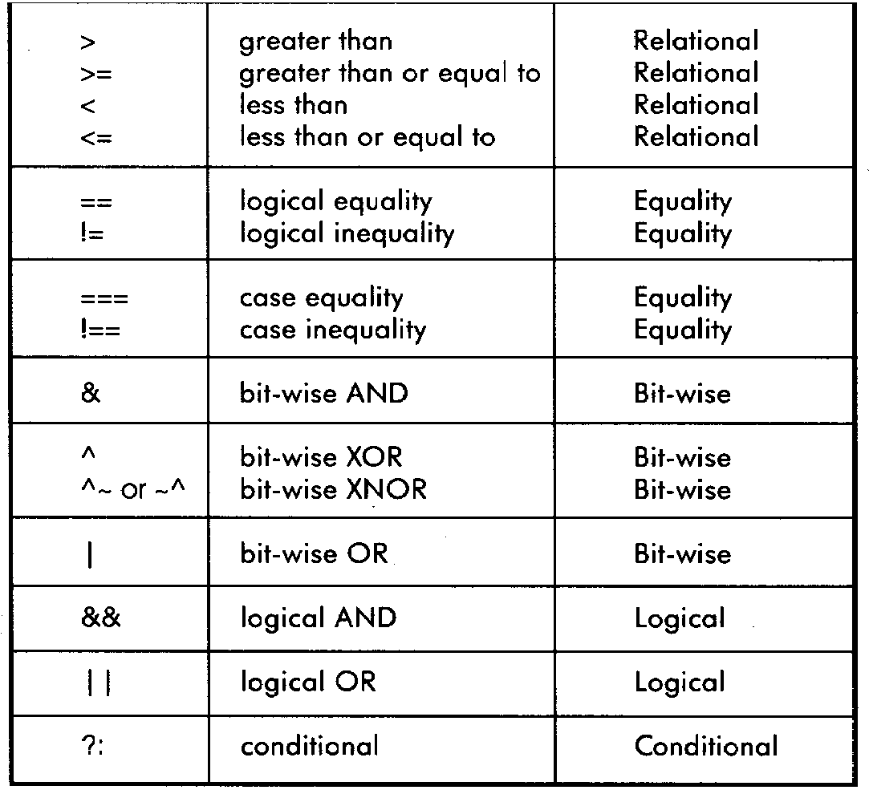
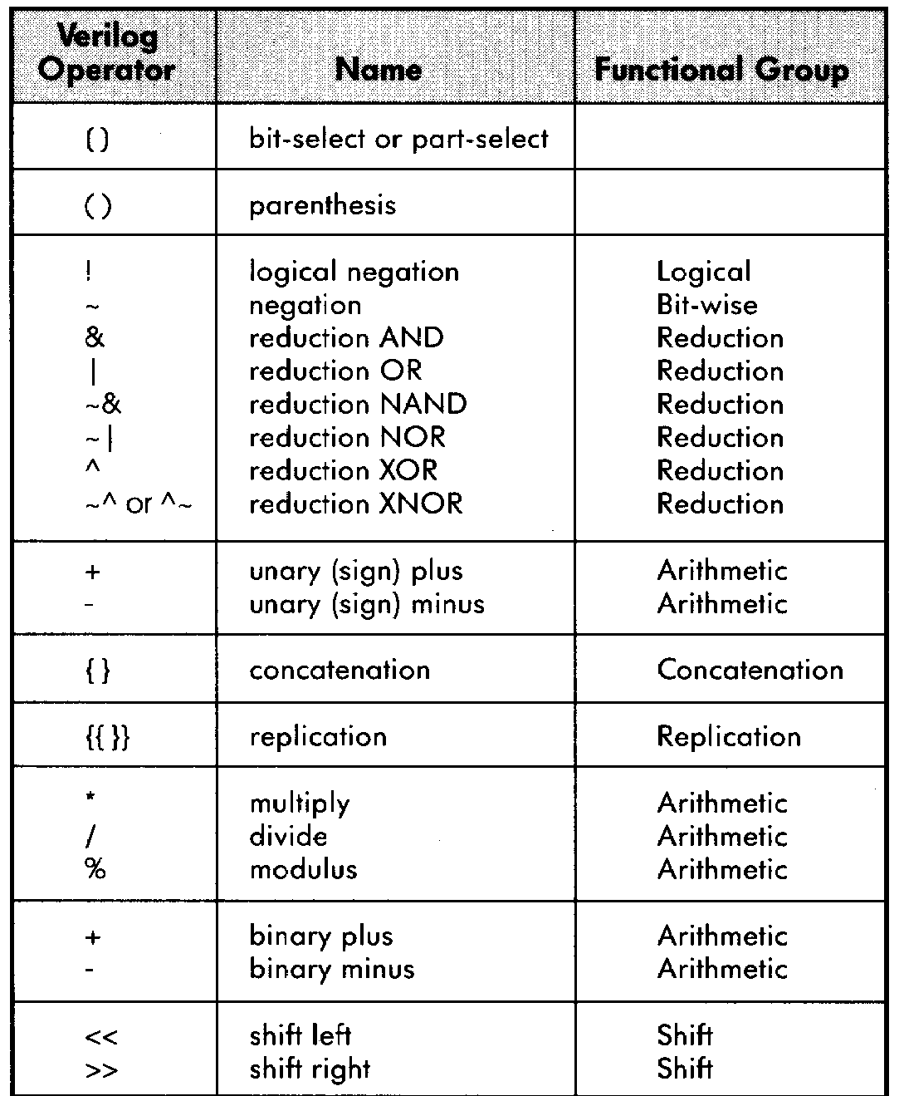
SystemVerilog Operator Precedence

Slide 13
Agenda
More operators
Conditional statements
Synchronous logic and assignments
Test benches for synchronous logic

Slide 14
Conditional Statements: The if Statement
Used in procedural blocks
Syntax:
if (condition1) begin
<statement1>;
end
else if (condition2) begin
<statement2>;
end
else begin
<statement3>;
<statement4>;
end

Slide 15
The if Statement - Example
Mux Module:
module mux (
input logic A,
input logic B,
input logic sel,
output logic Q
;(
always_comb begin
if (sel == 1'b0) begin
Q = A;
end
else begin
Q = B;
end
end
endmodule
A
0
Q
B
1
sel

Slide 16
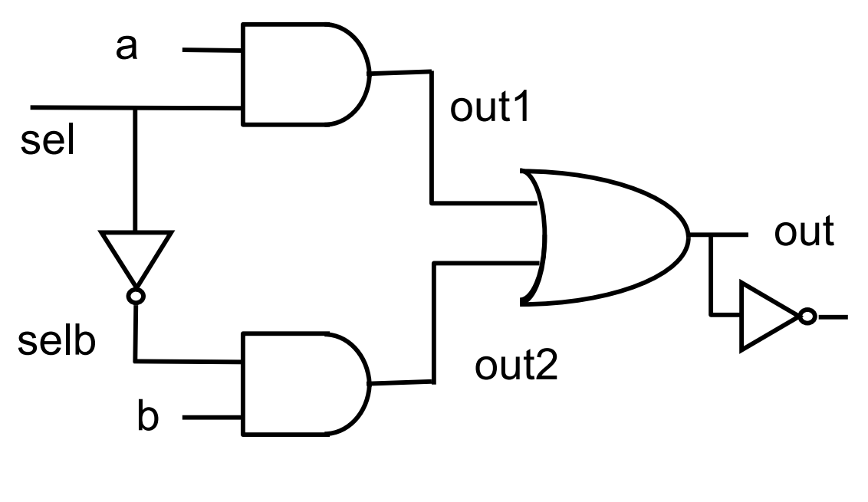
Reminder: Mux Implementation
module mux (
output logic out,
output logic outn,
input logic [1:0] in,
input logic sel
);
logic out1, out2, selb;
and a1 (out1, in[0], sel);
not i1 (selb, sel);
and a2 (out2, in[1] , selb);
always_comb begin
out = out1 | out2;
end
assign outn = ~out;
endmodule
in
In[0]
2
In[1]
outn

Slide 17
Conditional Statements: The case Statement
Used in procedural blocks
Syntax:
case (<signal/expression>)
<value1>: begin
<statement1>;
end
<value2>: begin
<statement2>;
<statement3>;
end
default: begin
<statement4>;
end
endcase

Slide 18

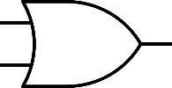
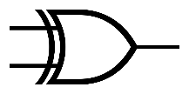
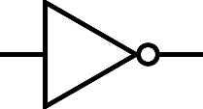
The case Statement - Example
module case_example (
input logic A,
input logic B,
input logic [1:0] w,
output logic Y
;(
always_comb begin
case (w)
2'b00: Y = A & B;
2'b01: Y = A | B;
2'b10: Y = A ^ B;
default: Y = ~B;
endcase
end
endmodule
A
B
00
01
Y
10
11
2
w

Slide 19
Conditional Statements: casex, casez
Variants of case Statements:
casex and casez
casez – ? and z are considered as don’t cares [0,1,z]
casex – ?, x and z are considered as don’t cares [0,1,x,z]
Example:
casez(w)
2'b1?: A = B + C;
2'b01: A = B ^ C;
default: A = B – C;
endcase

Slide 20
A Not-To-Do Example
module bad_mux (
input logic A,
input logic B,
input logic sel,
output logic Q
;(
always_comb begin
if (sel == 1'b1) begin
Q = A;
end
end
endmodule
A
Latch
I
O
Q
sel
G

Slide 21
Complete Assignments
always_comb should NOT be used for memory elements!
If a signal is not assigned in a certain flow, a memory element is implicitly created to preserve the previous value
Usually, this is a bug!
When using always_comb, always use complete assignments, i.e., assign values to all signals in all logic flows!

Slide 22
Complete Assignments: Guidelines
“if” statements
Use “else”
“case” statements
Use “default”
General solution
Use default assignments
always_comb begin
Q = 1'b0;
if (sel == 1'b1) begin
Q = A;
end
end
‘0’
0
Q
A
1
sel

Slide 23
Agenda
More operators
Conditional statements
Synchronous logic and assignments
Test benches for synchronous logic

Slide 24
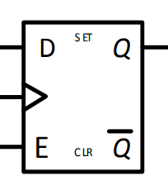
Flip Flop: Reminder

Slide 25

The always_ff Statement
always_comb: implements an asynchronous/ combinatorical block
always_ff: implements a synchronous block
clk

Slide 26
The always_ff Statement (without Reset)
Syntax:
always_ff @(posedge clk) begin
<sync statement1>;
<sync statement2>;
end
Sync Statements (on clock rise)
Sensitivity List

Slide 27
always_ff Example: Implementing a Flip-Flop
logic a, in;
always_ff @(posedge clk) begin
a <= in;
end
‘0’
in
a
clk
‘1’
‘0’

Slide 28
The always_ff Statement with Reset
Syntax:
Sensitivity List (no reset!)
With Asynchronous Reset:
With Synchronous Reset:
always_ff @(posedge clk, posedge rst) begin
if (rst == 1'b1) begin
<reset statement1>;
end
else begin
<sync statement2>;
end
end
always_ff @(posedge clk) begin
if (rst == 1'b1) begin
<reset statement1>;
end
else begin
<sync statement2>;
end
end
Sensitivity List
Initialization Statements (on reset)
Sync Statements (on clock rise)
Initialization Statements (on reset)
Sync Statements (on clock rise)

Slide 29
always_ff Example: Implementing a Flip-Flop with Reset
logic a, in;
always_ff @(posedge clk, posedge rst) begin
if (rst == 1'b1) begin
a <= 1'b0;
end
else begin
a <= in;
end
end
‘0’
in
a
clk
‘1’
rst

Slide 30
Assignment in an always_ff Block
In always_comb, we use a blocking assignment (= operator):
In always_ff, we use a non-blocking assignment (<= operator):
logic a, in;
always_comb begin
a = in;
end
logic a, in;
always_ff @(posedge clk) begin
a <= in;
end

Slide 31
Procedural Assignments
Occur within procedural blocks such as always_comb, always_ff and initial
Triggered when the flow of execution reaches them
Blocking/Non-blocking
Blocking assignment statement (= operator) acts much like in traditional programming languages. The whole statement is done before control passes on to the next statement
Non-blocking assignment statement (<= operator) evaluates all the right-hand sides for the current time unit and assigns the left-hand sides at the end of the procedural block

Slide 32
Example – Non blocking
module shifter(
input logic in,
input logic clk
;(
logic A, B, C;
always_ff @(posedge clk) begin
A <= in;
B <= A;
C <= B;
end
endmodule
in
A
B
C
clk

Slide 33
Example – Blocking
module bad_shifter(
input logic in,
input logic clk
;(
logic A, B, C;
always_ff @(posedge clk) begin
A = in;
B = A;
C = B;
end
endmodule
in
A
B
C
clk

Slide 34

Assignment Summary
Synchronous logic: Use non-blocking statements with always_ff blocks sensitive only to rising clock edge to mimic parallel synchronous logic.
Combinational logic: Use blocking statements inside always_comb blocks with to mimic logic flow of combinational logic.

Slide 35
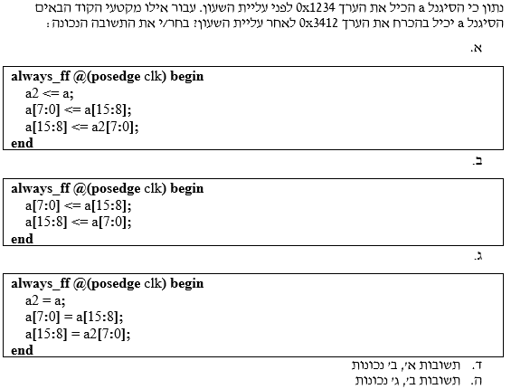
Assignment: A Question From an Exam (Winter '18-'19)

Slide 36
Example: Synchronous and Asynchronous Logic
Asynchronous/Combinatorical Logic
and_out
or_out
A
A
A
rst
B
B
clk
Synchronous Logic

Slide 37
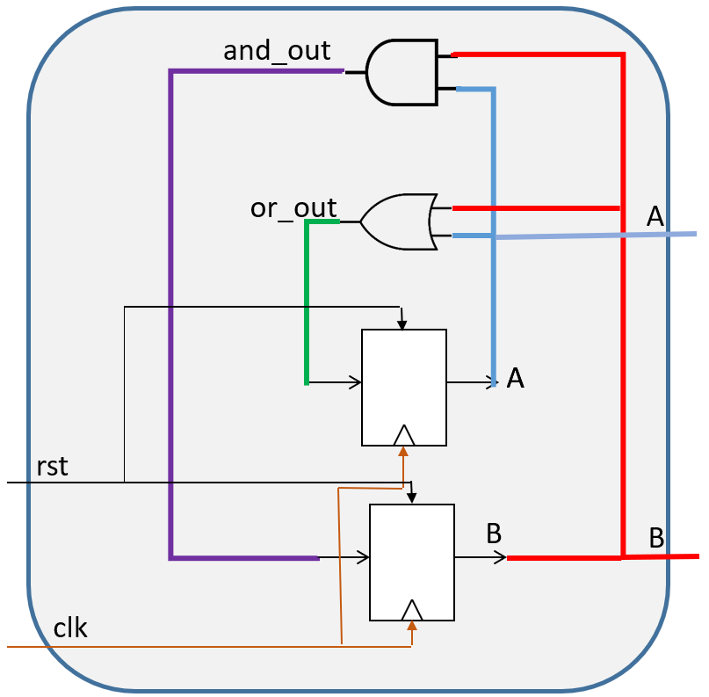
Example: Sync. and Async. Logic
module my_module (
input logic clk,
input logic rst,
output logic A,
output logic B
;(
logic and_out, or_out;
always_ff @(posedge clk, posedge rst) begin
if (rst == 1'b1) begin
A <= 1'b0;
B <= 1'b1;
end
else begin
A <= or_out;
B <= and_out;
end
end
always_comb begin
and_out = A & B;
or_out = A | B;
end
endmodule
Asynchronous/Combinatorical Logic
Synchronous Logic

Slide 38
Example: Sync. and Async. Logic: Another Implementation
module my_module (
input logic clk,
input logic rst,
output logic A,
output logic B
;(
always_ff @(posedge clk, posedge rst) begin
if (rst == 1'b1) begin
A <= 1'b0;
B <= 1'b1;
end
else begin
A <= A | B;
B <= A & B;
end
end
endmodule
Asynchronous &
Synchronous Logic

Slide 39
Agenda
More operators
Conditional statements
Synchronous logic and assignments
Test benches for synchronous logic

Slide 40
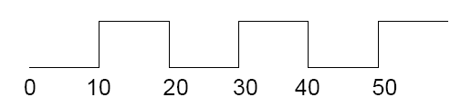
Test Bench: Generating a Clock Signal
initial begin
Clock = 1'b0;
end
...
always begin
#10 Clock = ~Clock;
end
always statement: runs in an endless loop
Clock

Slide 41
Test Bench: The Repeat Loop
Used in an initial block to repeat statements.
Syntax:
Example: Waiting for 4 clock cycles
repeat(num_of_times) begin
<statement1>;
<statement2>;
end
initial begin
repeat(4) begin
@(posedge clk);
end
end

Slide 42
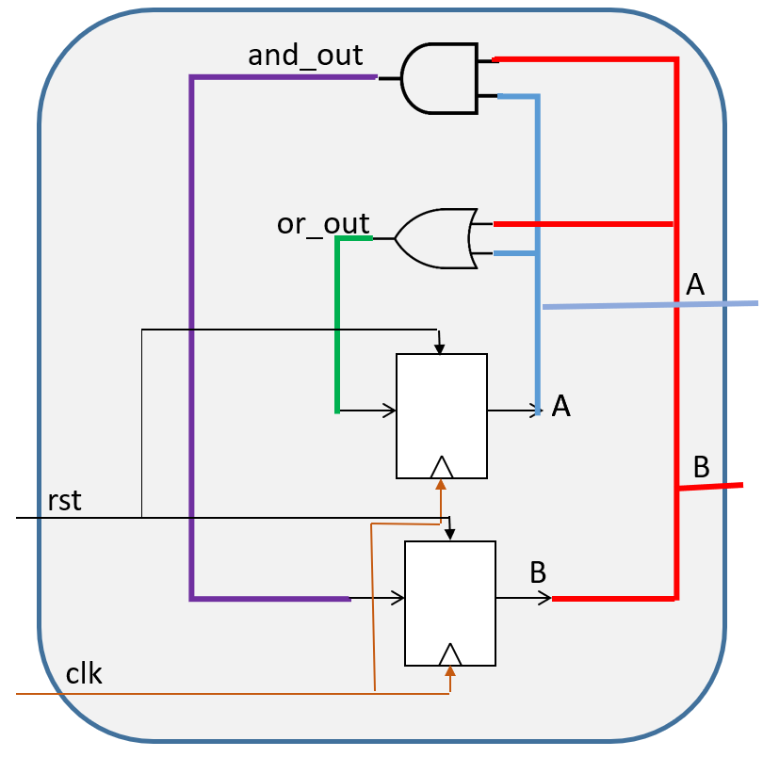
Test Bench: Full Example
module my_module_tb;
logic clk, rst;
logic A, B;
my_module inst(.clk(clk), .rst(rst), .A(A), .B(B));
always begin
#10 clk = ~clk;
end
initial begin
clk = 1'b0;
rst = 1'b1;
@(posedge clk);
7#
rst = 1'b0;
repeat(2) begin
@(posedge clk);
end
end
endmodule

Slide 43
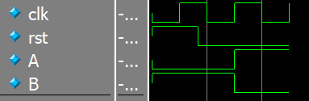
Test Bench: Full Example

Slide 44
Another Example: Simple Counter
+1
next_counter
current_counter
clk

Slide 45
Another Example: Simple Counter
logic [3:0] next_counter, current_counter;
always_ff @(posedge clk, posedge rst) begin
if (rst == 1'b1) begin
current_counter <= 4'b0;
end
else begin
current_counter <= next_counter;
end
end
always_comb begin
next_counter = current_counter + 1;
end
+1
next_counter
current_counter
clk

Slide 46
Another Example: Simple Counter
logic [3:0] current_counter;
always_ff @(posedge clk, posedge rst) begin
if (rst == 1'b1) begin
current_counter <= 4'b0;
end
else begin
current_counter <= current_counter + 1;
end
end
+1
current_counter
clk

Slide 47
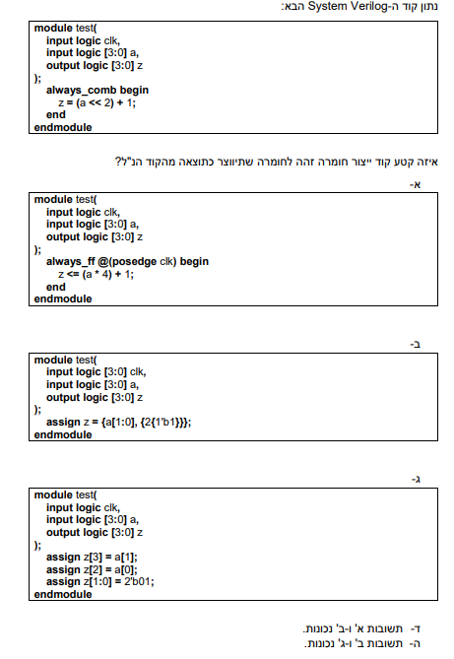
A Question From an Exam (Spring '19)

Slide 49
Workshop #3 Cheat Sheet
Logical operators: &&, ||, !
Relational operators: >, >=, <, <=, ==, !=
if statement:
if (condition1) begin
<statement1>;
end
else if (condition2) begin
<statement2>;
end
else begin
<statement3>;
<statement4>;
end

Slide 50
Workshop #3 Cheat Sheet
case statement:
casez: ? and z are considered as don’t cares [0,1,z]
casex: ?, z and x are considered as don’t cares [0,1,z,x]
case (<signal/expression>)
<value1>: begin
<statement1>;
end
<value2>: begin
<statement2>;
<statement3>;
end
default: begin
<statement4>;
end
endcase

Slide 51
Workshop #3 Cheat Sheet
always_ff statement:
always_ff with reset:
Async. Reset: Sync. Reset:
always_ff @(posedge clk) begin
<sync statement1>;
<sync statement2>;
end
always_ff @(posedge clk, posedge rst) begin
if (rst == 1'b1) begin
<reset statement1>;
end
else begin
<sync statement2>;
end
end
always_ff @(posedge clk) begin
if (rst == 1'b1) begin
<reset statement1>;
end
else begin
<sync statement2>;
end
end

Slide 52
Workshop #3 Cheat Sheet
Generating a clock signal:
repeat loop:
initial begin
Clock = 0;
end
...
always begin
#10 Clock = ~Clock;
end
repeat(num_of_times) begin
<statement1>;
<statement2>;
end

Slide 53

Questions?

